Slide 1
WELCOME

Slide 2

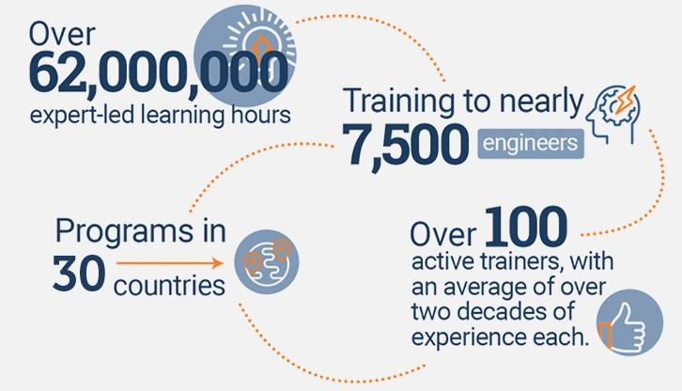
An Overview
Our purpose…
We help organizations learn and adopt new technologies.
In 2018 alone...
…Impacts you daily.
When you talk on the phone, watch a movie, connect with friends on social media, drive a car, fly on a plane, pay with a credit card, shop online, and order a latte with your mobile app, you are interacting with technology developed by one of our customers.
Notes:
Share a bit about DevelopIntelligence
- As developers you want to learn!
- As a corporation you want your developers to align their learning with your business goals.
- That’s where we come in… Keeping developers current, bringing others up-to-speed … all aimed at moving your business forward!
- We started in 2003 by a Sun Microsystems developer that wanted to help developers level-up and see business better leverage IT

Slide 3
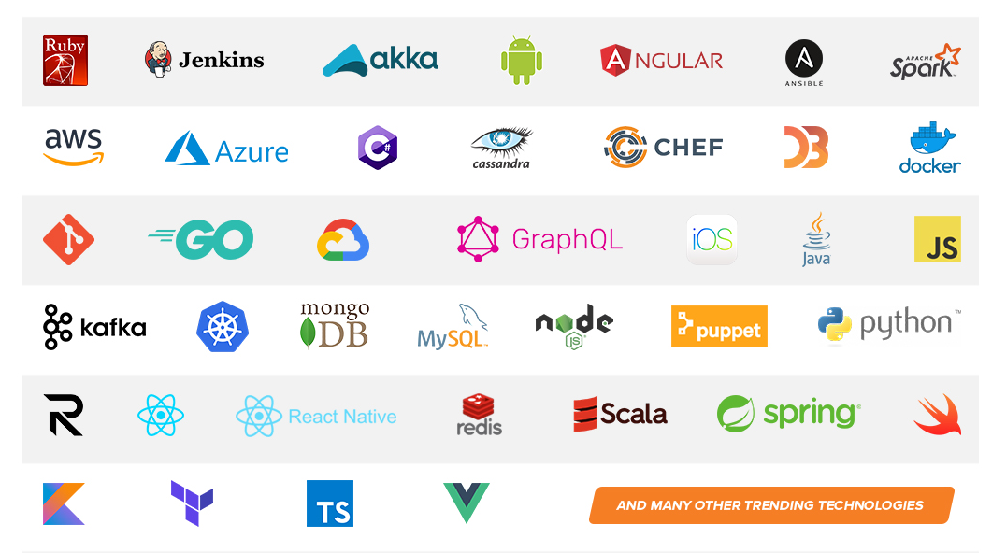
Technologies we cover
Notes:
Areas of DevelopIntelligence expertise
DevOps: Ansible / Jenkins
BigData: Hadoop / Cassandra / Spark
Machine Learning
Front-end: React / Angular
Cloud: AWS / Azure / Google Cloud
- Started as a Java shop -> keep growing -> haven’t looked back
- Our specialty is hiring expert practitioners that can come alongside teams and teach them how to move forward

Slide 4
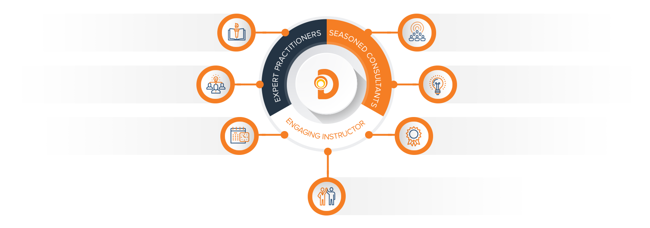
Our Practitioners
250 best selling
books authored
150 engagements speaking
at industry conferences
9+ years of training
experience
Over 17 years of industry
experience per instructor
750,000 practitioner led
training hours
125 certifications in leading
technologies
95% instructor satisfaction

Slide 5
About the instructor

Slide 6
Snowflake
Instructor Name
Credentials

Slide 7
What is Snowflake?
Agenda:
This class is designed to teach students the basic uses of snowflake. We’re going to go over the four basic elements of using snowflake:
Accessing Snowflake
Creating Users/Roles/Permissions
Inserting data
Querying data

Slide 8
What is Snowflake?
” Snowflake is a data warehouse built on top of the Amazon Web Services or Microsoft Azure cloud infrastructure. There’s no hardware or software to select, install, configure, or manage, so it’s ideal for organizations that don’t want to dedicate resources for setup, maintenance, and support of in-house servers.”
--Snowflake Handbook

Slide 9
Why Snowflake?
Has anyone ever set up a MYSQL, POSTGRESQL, MSSQL, ORACLE or other data warehouse instance?
What are some of the issues that you had to face?
What are some of the hardships?
How do you handle demand changes ?
How do you handle high query demands?

Slide 10
Traditional Enterprise Data Warehouse Architecture
So if we were to jump into the “wayback machine” we would find that initial data warehouses were single-server and tightly coupled machines.
Storage of data, computation of data, and services were all held on a single machine
This leads to a myriad of problems, including:
Possible data loss
Concurrency issues
WHAT IF THE SERVER BREAKS?!?

Slide 11
Shared Disk Servers
The shared-disk architecture was the first approach to emerge for scaling beyond the single-node SMP architectures of early systems.
It is designed to scale processing beyond a single server while keeping data in a central location.
In a shared-disk system, all of the data is stored on a storage device that is accessible from all of the nodes in the database cluster.
Any change in the data is updated and reflected in the single storage location.

Slide 12
Shared Disk Servers
Shared-disk architectures are attractive for their simplicity of data management: all processing nodes in the database cluster have direct access to all data, and that data is consistent because all modifications to the data are written to the shared disk

Slide 13
Shared Disk Servers
The issue is: the scalability of this architecture is severely limited because even a modest number of concurrent queries will overwhelm the storage device and the network to it, forcing processing to slow down for data to be returned from the shared disk.
Additional compute nodes only exacerbate the overloaded shared disk. Further, complicated on-disk locking mechanisms are needed to ensure data consistency across the cluster.

Slide 14
Shared Nothing
To avoid these issues, Snowflake uses something known as a “SHARED NOTHING” architecture.
The shared-nothing architecture scales processing and compute together by distributing different subsets of data across all of the processing nodes in the system, eliminating the bottleneck of communication with a shared disk

Slide 15
Shared Nothing
From Wikipedia:
“A shared-nothing architecture (SN) is a distributed computing architecture in which each node is independent and self-sufficient, and there is no single point of contention across the system. More specifically, none of the nodes share memory or disk storage.”

Slide 16
Shared Nothing Drawbacks
So- there ARE issues with Shared Nothing architecture:
As the cluster is scaled to more and more nodes, the fact that data is distributed across the cluster requires shuffling data between nodes.
That shuffling adds overhead that reduces performance and makes performance heavily dependent on how data is distributed across the nodes in the system.
Distribution of data across compute nodes is typically done through static assignment--data is distributed at the time it is loaded by either a user specified distribution key or by a default algorithm
Changing the data distribution typically requires completely redistributing data across the cluster or even unloading and reloading data. This is a slow and disruptive operation, often requiring queries to pause and blocking queries that modify data.

Slide 17
Downsides to Shared Nothing
Shared-nothing architectures make it very difficult to select the right balance of storage and compute.
Because the cluster must be sized to house all data, compute resources may be more than needed for actual queries or may be insufficient for the queries run on the system.
Because of the time required to resize the cluster (if even possible to do so), organizations frequently overprovision these clusters, resulting in wasted resources and spend

Slide 18
Snowflake is a hybrid of Shared Nothing and Disk
So how does Snowflake address these shortcomings?
The idea here is that by using the cloud based infrastructure SNOWFLAKE can essentially throw resources at the management of shared-nothing infrastructure indefinitely.
This is because Snowflake is elastic in nature- it will expand as resources are required and contract when not required.
This addresses both the high compute requirements of Shared Nothing AND the high-cost requirements of creating “workers”

Slide 19
Massive Parallel Processing
Snowflake is a shared-nothing or massive parallel processing system.
Imagine if you will, for a minute, a series of workers, each of whom have their own memory, resources, and processors assigned to a task.
We can split the task among these workers thereby speeding up the task immeasurably.
This brings us to our definition of MPP:
“MPP (massively parallel processing) is the coordinated processing of a program by multiple processor s that work on different parts of the program, with each processor using its own operating system and memory”

Slide 20
What does Snowflake offer?
Let’s divide data warehouses into three parts:
Storage: for storing data and
Computing: which is what allows us to do all the things we do in structured SQL databases
Services: Which are some of the things like pipelines, etc.
Snowflake offers us the opportunity to independently scale the storage, services, and the computing. Why is this important?

Slide 21
Snowflake: Why this design?
In a traditional data warehouse, storage, compute, and database services are tightly coupled.
This can stem from either the configuration of the physical nodes (even in the cloud), or the architecture of the data warehouse appliance. Even “big data” platforms tie storage, compute and services tightly together within the same nodes.
Big data platforms can scale compute and storage to some degree, but they still suffer from the same predictable performance limitations as the number of workloads and users increase.

Slide 22
Snowflake Intro
“Snowflake is a single integrated solution with completely independent scaling for compute, storage and services. Unlike shared-storage architectures that bundle storage and compute together, Snowflake enables instant, automatic scaling of storage, analytics, or workgroup resources for any job at any time.”
-- Snowflake handbook

Slide 23
Snowflake Architecture
Starting with our conception that there are three layers (storage, computing, services) to a data warehouse we would want to separate those out.
For storage let’s keep everything in file formats (AVRO, JSON, etc).
Think data lake… a large data repository accessible by multiple clusters.
NOW- For the computing layer we would want clusters of computers set up to share resources for running computations on that storage.
Finally in the services layer we want access from our cloud service provider.

Slide 24
Snowflake architecture

Slide 25
Snowflake Intro: Storage
Storage:
So in our storage layer we can keep structured or semi-structured data that Snowflake completely manages for us! (I can’t adequately emphasize how awesome this is!)
Snowflake automatically manages all aspects of how the data is stored: organization, file size, structure, compression, metadata, and statistics. This storage layer runs independently of compute resources.
Storage is billed in terabytes per month and is incredibly cheap.

Slide 26
Snowflake Intro: Computing Layer
Computing:
The compute layer is made up of virtual warehouses that execute data processing tasks required for queries. Each virtual warehouse (or cluster) can access all the data in the storage layer, then work independently, so the warehouses do not share, or compete for, compute resources.
This enables nondisruptive, automatic scaling, which means that while queries are running, compute resources can scale without the need to redistribute or rebalance the data in the storage layer.

Slide 27
Snowflake Intro: Services Layer
The cloud services layer uses ANSI SQL and coordinates the entire system. It eliminates the need for manual data warehouse management and tuning. Services in this layer include:
Authentication
Infrastructure management
Metadata management
Query parsing and optimization
Access control

Slide 28
Snowflake Architecture

Slide 29
Snowflake Elasticity
The idea behind the design and architecture of Snowflake was always that it would be built completely on the cloud and 100% cloud native.
It needs to be elastic- able to expand and contract in accordance with demand.
It needs to be fully managed. YOU (the user) should not be utilizing DBAs to provision and manage more and more servers for your demand; snowflake is designed to take all of that off of your plate.
It needs to have native support for various data types. We need it to be able to understand JSON, AVRO, XML, etc without the clunky utilization of poorly built and sourced plugins.

Slide 30
Snowflake Data Types
Snowflake offers native ingestion of various data types that other data warehouses don’t.
Have any of you ever been in a scenario where you needed to load, say, an XML or a multi-dimensional JSON into a structured SQL database?
How did you have to manipulate that data?
How much work did it take to get it in there?
Did you have to flatten it first?
The makers of snowflake felt your pain here and offer the VARIANT data type.

Slide 31
Snowflake data types
Snowflake started by making it possible to flexibly store semi-structured records inside a relational table in native form
This is accomplished through a custom datatype (Snowflake’s VARIANT datatype) that allows schema-less storage of hierarchical data, including JSON, Avro, XML and Parquet
This makes it possible to load semi-structured data directly into Snowflake without pre-processing, losing information, or defining a schema
You simply create a table containing a column with Snowflake’s VARIANT datatype and then load files containing semi-structYou simply create a table containing a column with Snowflake’s VARIANT datatype and then load files containing semi-structured data into that table. ured data into that table.

Slide 32
Snowflake Variant data types
When Snowflake loads semi-structured data, it automatically discovers the attributes and structure that exist in the data to optimize how it’s stored.
It looks for repeated attributes across records, and then organizes and stores those repeated attributes separately, enabling better compression and fast access similar to the way that a columnar database optimizes column storage
Statistics about these pseudo-columns are also calculated and stored in Snowflake’s metadata repository for use in optimizing queries

Slide 33
Snowflake Data Types
So why is this an advantage?
Have any of you had to deal with working with a SQL and NOSQL database side by side?
Maybe HADOOP for some data and POSTGRESQL for other data?
The idea behind Snowflake is that it’s a one-stop-shop where you can store and process all of this data in one place.

Slide 34
Snowflake Elasticity
Snowflake has a novel concept to deal with elasticity:
By isolating each layer they can expand and contract independently of each other.
This means that we can deal with the DATA STORAGE, COMPUTE and USERS (Services) layer without effecting the other ones.
Let’s go into each of these

Slide 35
Snowflake Elasticity
Data:
The amount of data stored can be increased or decreased at any time. Unlike shared-nothing architectures where the ratio of storage to compute is fixed, the compute configuration is determined independently of the volume of data in the system.
This architecture also makes it possible to store data at a very low cost because no compute resources are required to store data in the database.

Slide 36
Snowflake Elasticity
Compute:
The compute resources being used for query processing can also be scaled up or down at any time as the intensity of the workload on the system changes.
Because storage and compute are decoupled, and the data is dynamically distributed, changing compute resources does not require reshuffling the data. Compute resources can be changed on-the-fly, without disruption.

Slide 37
Snowflake Elasticity
Users:
With most data warehouses, there’s a fundamental limit to scaling concurrency because all of the queries are competing for the same resources. As more users and workloads are added, the system gets slower and slower. Regardless of how large the cluster becomes, eventually the system cannot support additional concurrency and the only option is to create a new datamart.
This brings with it the extra management burden of replicating or migrating data across systems. Snowflake can scale to support more users and workloads without performance impact because multiple virtual warehouses can be deployed on-demand, all with access to the same data.

Slide 38
Snowflake Automation
So now let’s talk about a lot of the “under the hood” things that Snowflake can do for us, including:
Time Travel:
Enables you to immediately revert any table, database or schema to a previous state. It’s enabled automatically and stores data as it’s transformed for up to 24 hours, or 90 days in enterprise versions.
Copying to clone:
Most data warehouses require you to copy data to clone, forcing a large amount of manual effort and a significant time investment.
Snowflake’s multi-cluster, shared data architecture ensures that you never need to copy any data, because any warehouse or database automatically references the same centralized data store

Slide 39
Snowflake Automation
Data distribution:
Managed automatically by Snowflake based on usage.
Rather than relying on a static partitioning scheme based on a distribution algorithm or key chosen by the user at load time, Snowflake automatically manages how data is distributed in the virtual warehouse. Data is automatically redistributed based on usage to minimize data shuffling and maximize performance.
Loading Data:
Complex ETL data pipelines are no longer needed to prepare data for loading. Snowflake natively supports and optimizes diverse data, both structured and semi-structured, while making that data accessible via SQL.

Slide 40
Snowflake Automation
Dynamic query optimization:
Ensures that Snowflake operates as efficiently as possible by looking at the state of the system when a query is dispatched for execution, not just when it is first compiled.
Dynamic query optimization:
Ensures that Snowflake operates as efficiently as possible by looking at the state of the system when a query is dispatched for execution, not just when it is first compiled.

Slide 41
Snowflake Advantage
USE THE SQL THAT YOU ALREADY KNOW
Rather than dealing with NOSQL and the like you can use SQL that your team is already familiar with to create dynamic, powerful, fast moving queries.

Slide 42
Confused? ASK QUESTIONS

